Slide 1
Web Editing With Adobe Experience Manager (AEM)
Training FOR Departmental Web Editors
Thursday, November 9, 2016

Slide 2
Welcome I’m excited to walk you through the ins and outs of Adobe Experience Manager, which we will be referring to as AEM, your new software tool for managing your department website.
At the conclusion of this training session you will be able to:
Login to AEM, through a secure portal (UM Shibboleth Web Login).
Know how and where to locate your web editing interface(s) in AEM.
Understand the navigational scheme of your website in AEM.
Know how to create new navigation on your site, both audience-based (homepage) and within your site.
Know how to create a new webpage in AEM.
Know how to build a page utilizing a variety of AEM components.
Understand the steps to adding News, People and Events to your site.
Understand activation and deactivation (publishing and unpublishing).
Understand versioning in AEM.

Slide 3
Web Services is Here for YOU
Your job as a web editor - regardless of whether it’s 10% of your role or 79% of your role - is EXTREMELY important to your department’s success.
lsa.web.support@umich.edu - Help Desk
lsa.umich.edu/webservices: Our AEM site with Online Help Documentation.
Open Labs 2x per week, right here. Hands-on support by Web Services team. Please sign up on the AEM Support/Open Lab section of our website.

Slide 4
Janet Redish Letting Go of the Words
People come to web sites to satisfy goals, to do tasks, to get answers to questions.
Navigation, search, design, and technology support the content that people come for.
Know Thy Audience
Many of you are Student Services Veterans. You’ve answered the same questions hundreds of times.
Are those questions answered on your current site?
Are there new questions that will emerge as a result of new programming?
Understanding WHY your audience comes to your site will help you select and organize the content so that it best meets both your goals and theirs.
REMEMBER: In many case, students and other web users are coming to your website to replace the act of making a phone call/have a conversation.
Some of the best thinking on the subject of writing for the web is found in Janice Redish’s book Letting Go of the Words. Redish shares many of the most important truths about web content in her summary of Chapter 1 (“Content! Content! Content!”)

Slide 5
Terminology Overview: AEM User Interface The AEM user interface combines the advantages of a web interface with the fluidity and responsiveness usually associated with desktop applications. AEM employs the following features…
Web Content Manager Console: The Web Content Manager (WCM) presents a consistent "explorer-like" interface (similar to Open Text’s App Console, but better). For example, the WCM console (referred to in this documentation as the Site Administration Interface) features a two-pane interface with a dynamic expandable/collapsible tree on the left and a grid with draggable rows and columns on the right.
Sidekick: A floating window that appears on the inside of a page in the on-page editing interface from which you may add new components or execute page actions.
Content Finder: On the left side of each page in the on-page editing interface, this pane provides quick access to digital assets such as images and documents as well as other pages of your site. Assets can be dragged on to your page after a component is created.
On-Page Editing: Components can be edited directly on the webpage.
Drag and drop: Columns and other components, including digital assets can be positioned on the page simply by dragging and dropping them in the desired location.
Contextual menu: Right clicking on most onscreen elements brings up a context menu with appropriate action options; similar to a desktop OS interface.

Slide 6
Some Thoughts about Roles…
AEM is designed for multiple users who may, if desired, have differing levels of responsibility.
*One of the main reasons for assigning content management roles within a department is to help with SEO (Search Engine Optimization).
The Internet looks for “Organized and Labeled” content, which means content that is tagged with metadata (titles, keywords, descriptions, etc.).
Having one or two people thinking about this and executing it, is a REALLY GOOD IDEA.

Slide 7
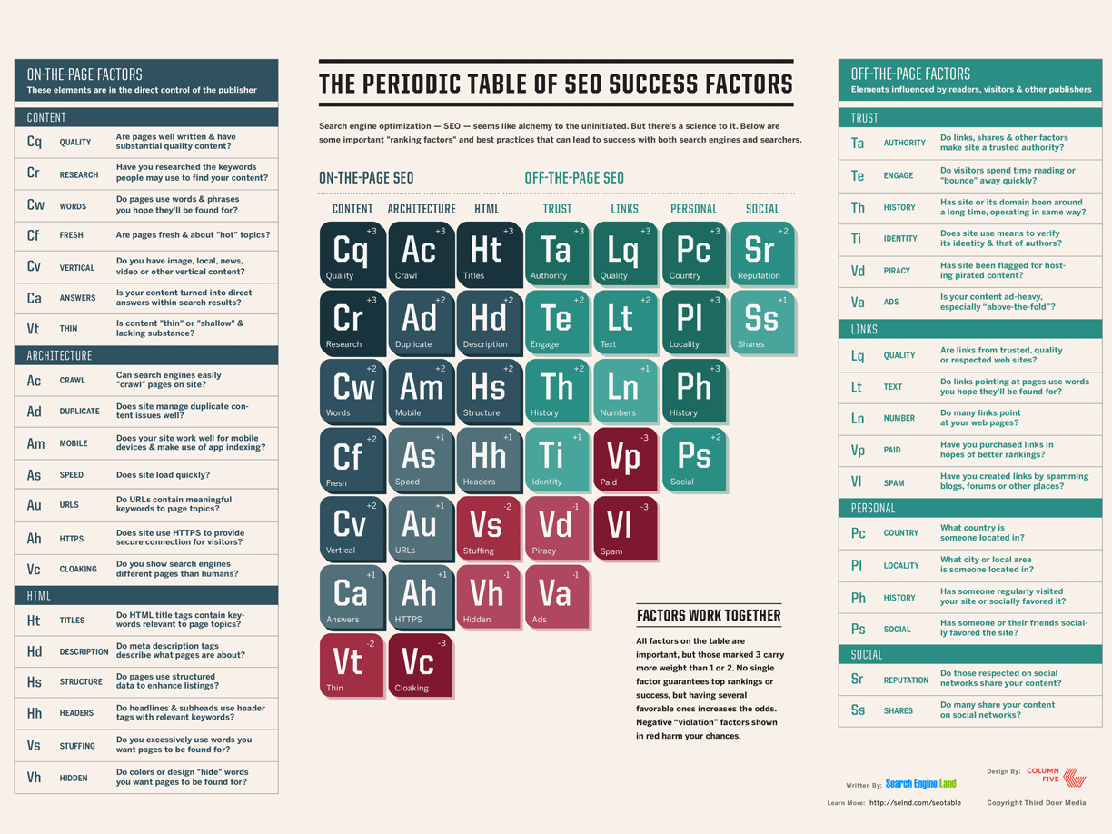

Slide 8
AEM Roles
Site Administrator
Website Managers who are comfortable editing site configuration (Chapter 3).
Please assign this role to the person in your dept. most comfortable with web software.
Content Authors
Build pages.
Set up/design/manage content.
Restricted to your own departmental site(s), will not see any other departments content listed, just what you have permission to see.
DAM Admin (Highly Recommended)
Manage all Media assets for site (images, documents, audio, video).
Ensure metadata added to all DAM content. When metadata well managed, authors can more easily locate content based on needs, and internet searches can more easily return your content at the top of results pages.
Similar to tag admins, DAM admins manage and categorize content.

Slide 9
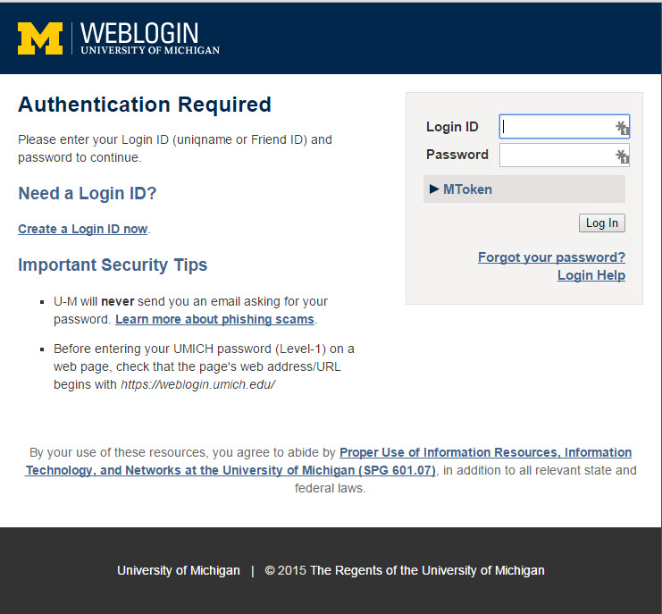
Getting to Know the AEM Environment
As an author in the AEM web environment, you will access your website in what we call the “Production" Environment @ author.lsa.umich.edu
Notice the only difference between your AEM and Open Text editing sites is the word Author at the start of the URL. Feel free to bookmark this page, just as you did your edit.lsa.umich.edu page in Open Text.
The first time you navigate to your site address, you will be presented with the now familiar Shibboleth WEBLOGIN that indicates AEM is part of the University of Michigan IT infrastructure.

